Slide 1
Introduction to
Artificial Intelligence and Machine Learning
Chapter 1

Slide 2
Content
Definition of Artificial Intelligence
History of Artificial intelligence
Subfields of Artificial Intelligence
The connection between AI and Machine learning

Slide 3
What is Intelligence
Intelligence means being able to understand, learn, think, adapt, and solve problems.
It is the ability to take in information, make sense of it, and use it to make good decisions or actions.
AI tries to copy this kind of human intelligence using computer programs and algorithms.

Slide 4
Definition of Artificial Intelligence
Artificial Intelligence (AI) is the field that creates machines that can act and think in ways similar to humans.
AI uses many techniques and algorithms to help computers do tasks that normally require human intelligence, such as understanding language, recognizing images, or making decisions.

Slide 5
Artificial Intelligence Tasks
Reasoning:
AI can follow logical steps and make conclusions based on the information it has.
Problem-Solving:
AI can break big problems into smaller parts, test different options, and choose the best solution.
Perception (Seeing & Hearing):
AI can take in information from sensors or cameras—like images or sounds—and understand what it sees or hears.
Natural Language Understanding:
AI can read, listen to, and understand human language. This enables tools like chatbots, virtual assistants, and translation apps.

Slide 6
More of AI Tasks
Learning:
AI learns from data and improves its performance over time.
Autonomy:
AI can make decisions and act without constant human control.
Adaptability:
AI changes its behavior when the situation or environment changes.
Human-like Simulation:
AI copies some aspects of human thinking to solve specific tasks.
Interdisciplinary Nature:
AI uses ideas from many fields—computer science, math, psychology, neuroscience, and engineering.

Slide 7
AI as the Field of Creating Intelligent Agents
Artificial Intelligence focuses on building intelligent agents—machines that can act smartly.
These agents can understand their environment, make decisions, and take actions to reach goals.
They are designed to mimic some human abilities, and sometimes even perform better than humans.
This idea of intelligent agents is the foundation of many modern AI applications.
.

Slide 8
Examples of intelligent agents
Self-Driving Cars:
Use sensors and AI to understand the road, make driving decisions, and adapt to traffic.
Virtual Assistants (Siri, Alexa, Google Assistant):
Understand spoken language, answer questions, and learn user preferences.
Recommendation Systems (Netflix, Amazon):
Suggest movies, products, or content by learning from what users like and choose.

Slide 9
Examples of intelligent agents
Autonomous Robots in Manufacturing:
Robots that assemble products, check quality, and handle materials while adapting to changes in the production process.
Medical Diagnosis Systems:
AI tools that help doctors read medical images, detect diseases, and choose suitable treatments.
Game-Playing AI (AlphaGo, GPT models):
AI that learns strategies and makes smart decisions to win games like chess or Go.

Slide 10
Levels of Artificial Antelligence
Narrow AI (Weak AI):
AI that is good at one specific task only, like chatbots or recommendation systems.
General AI (AGI):
AI that can think and learn like a human and handle many different tasks.
We do not have AGI yet.
Super AI:
AI that would be smarter than humans in all areas.
This raises ethical and safety concerns.

Slide 11
AI Development Spectrum
AI development moves through three main stages:
Narrow AI → General AI (AGI) → Super AI
Today’s AI is Narrow AI, which is strong in specific tasks only.
Researchers are currently working toward AGI, which would match human intelligence.
Super AI is a future possibility where machines surpass human intelligence.

Slide 12
Brief History of AI
1950s – Birth of AI
Term “Artificial Intelligence” introduced.
Focus on logic and symbolic reasoning.
1960s–70s – Expert Systems
AI systems built to imitate human experts.
1997 – Deep Blue Beats Kasparov
IBM’s AI defeats the world chess champion.
Major milestone showing AI’s power.
2000s – Machine Learning Returns
Rising interest in ML.
Neural networks and backpropagation improve.
2010s – Deep Learning Era
Big breakthroughs in vision and language.
AI becomes part of everyday applications.
Notes:
An expert system is a computer program or software application that emulates the problem-solving and decision-making abilities of a human expert in a specific domain. It achieves this by storing a vast knowledge base of domain-specific information, rules, and heuristics gathered from experts, and using an inference engine to make recommendations or decisions based on the knowledge. Expert systems are designed to provide users with expert-level guidance, explanations, and solutions, making them valuable tools for automating complex decision-making processes in various fields while ensuring consistency and reliability.

Slide 13
Subfields of Artificial Intelligence
NLP (Natural Language Processing): Focus on language understanding, generation, and communication between humans and machines.
Computer Vision: Enables machines to interpret and analyze visual information from images and videos.
Expert Systems: Develops systems that mimic human expertise for decision-making in specialized domains.
Robotics: Involves the creation of physical or virtual robots capable of interacting with the environment.
Machine Learning: Subfield dedicated to developing algorithms that allow machines to learn from data and improve performance.

Slide 14
Natural Language Processing (NLP)
Definition: NLP helps computers understand and work with human language—both spoken and written.
Examples:
Chatbots & Virtual Assistants: Siri, Alexa, and others understand and answer questions.
Machine Translation: Tools like Google Translate convert text between languages.
Sentiment Analysis: AI checks reviews or posts to see if people feel positive or negative.
Text Summarization: AI creates short summaries of long articles.
Content Generation: AI tools create text, such as ChatGPT.

Slide 15
Computer Vision
Definition: Computer Vision allows machines to see and understand visual information from images and videos.
Examples:
Facial Recognition: Unlocking phones or enhancing security.
Object Detection: Used by self-driving cars to avoid obstacles.
Medical Imaging: AI analyzes CT scans and MRIs to help diagnose diseases.
Image Captioning: AI creates text descriptions for images.
Image Generation: AI creates images or videos from input prompts (e.g., Midjourney).

Slide 16
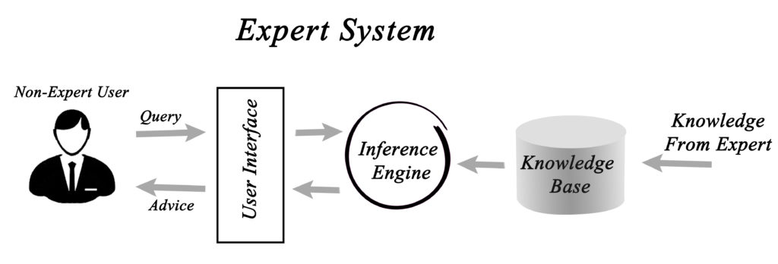
Expert Systems
Definition: Expert systems are AI programs that imitate human experts in a specific field. They use stored knowledge and logical rules to make decisions and solve problems.
Examples:
Healthcare Diagnosis: Helps doctors identify diseases based on symptoms and medical data.
Financial Advisory: Gives investment advice by analyzing markets and financial information.
Customer Support Chatbots: Answer customer questions using expert-level knowledge.

Slide 17
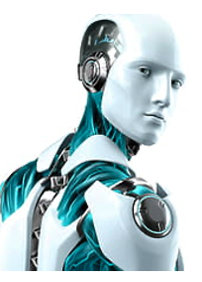
Robotics
Definition: Robotics focuses on building and controlling robots—machines that can interact with and manipulate the environment.
Examples:
Manufacturing Robots: Assemble products and perform repetitive tasks in factories.
Medical Robots: Help surgeons perform precise, minimally invasive operations.
Autonomous Drones: Fly on their own to collect data or survey areas.
Home Assistant Robots: Devices like robotic vacuum cleaners that help with daily tasks.

Slide 18
AI vs.Machine learning vs. Deep Learning

Slide 19
AI vs. ML vs. Deep Learning (Overview)
Artificial Intelligence (AI)
The broad field of building machines that can think and act intelligently.
Machine Learning (ML)
A subset of AI where machines learn from data.
Deep Learning (DL)
A subset of ML that uses multi-layer neural networks to learn from large amounts of data.
Relationship (simple):
AI ⟶ ML ⟶ Deep Learning
(Each one is inside the other)

Slide 20
Artificial Intelligence (AI)
Definition:
AI is about creating systems that can understand, reason, learn, and make decisions like humans.
Examples:
Self-driving cars
Smart assistants (Siri, Alexa)
Facial recognition
Robots
Medical diagnosis systems
Key idea:
AI = the whole field of intelligent machines.

Slide 21
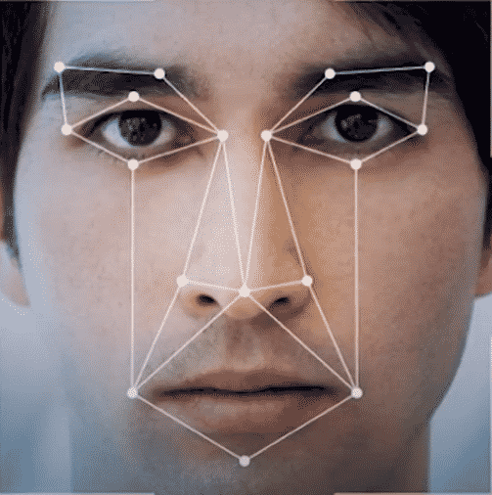
Machine Learning
Definition: the development of algorithms that enable machines to learn from data, make predictions, and improve their performance over time.
Examples:
  Image Recognition: ML algorithms can identify objects and patterns in images, used in facial recognition and self-driving cars.
  Recommendation Systems: ML powers personalized content recommendations on platforms like Netflix and Amazon.
  Natural Language Processing (NLP): ML models understand and generate human language, used in chatbots and language translation.
  Healthcare Diagnostics: ML assists in disease detection and diagnosis by analyzing medical data.

Slide 22
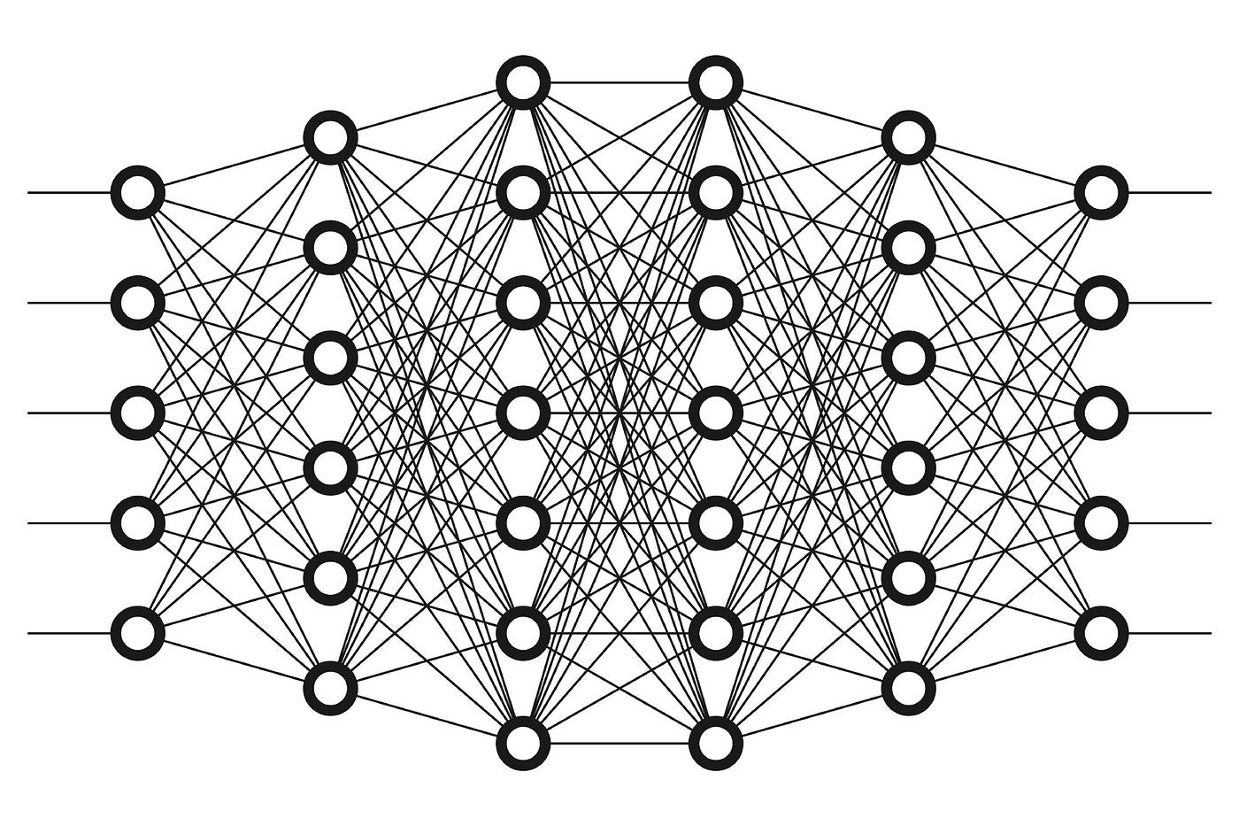
Deep Learning
Definition: a subfield of Machine Learning that employs artificial neural networks, often with multiple layers (deep neural networks), to model and solve complex tasks, mimicking human brain functions.
Examples:
  Image Classification: Deep learning powers image recognition systems, such as identifying objects in photos.
  Speech Recognition: Virtual assistants like Siri and Google Assistant use deep learning to understand spoken language.
  Autonomous Vehicles: Deep learning enables self-driving cars to perceive their surroundings and make driving decisions.
  Language Translation: Deep learning models improve the accuracy of language translation services.

Slide 23
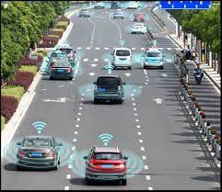
The Connection Between AI and Machine Learning
AI and Machine Learning
  AI is the broader field that encompasses various techniques, including Machine Learning (ML).
  ML is a subset of AI that focuses on learning from data to make predictions and decisions.
AI and ML Collaboration:
  AI systems leverage ML to enhance their capabilities.
  ML algorithms enable AI systems to adapt, learn, and improve based on the data they encounter.
Example:
  A self-driving car is an AI system that uses ML to recognize objects, make driving decisions, and improve its performance with more data.

Slide 24
Role of Data in AI
Data as the Lifeblood:
  Data is the foundation of AI, providing the necessary information for learning and decision-making.
Training AI Models:
  AI systems, including ML algorithms, require large and diverse datasets for training.
  The quality and quantity of data significantly impact AI performance.
Data-Driven Insights:
  AI uses data to gain insights, make predictions, and drive informed decisions in various applications, from business analytics to healthcare.

